Slide 1
Shell Bootcamp 2024 3 Reflections for Week #<>
Anvitha Vadlamudi
Date : 06-Sept-2024

Slide 2

About Me
My Motto: Stay healthy and happy :)

Slide 3

My learnings from this week!

Slide 4
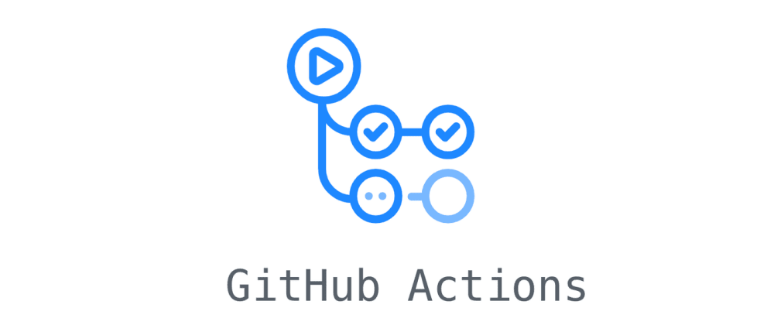
Learning 1 | My takeaways
Key learning: GitHub actions
Key takeaways: Learned to automate tasks like CI/CD, build, and deploy code. Set up workflows for continuous integration using GitHub Actions.
How do I personally see this concept implemented in the Energy sector: In the energy sector, automated workflows reduce manual errors and increase efficiency in software updates and deployments.

Slide 5
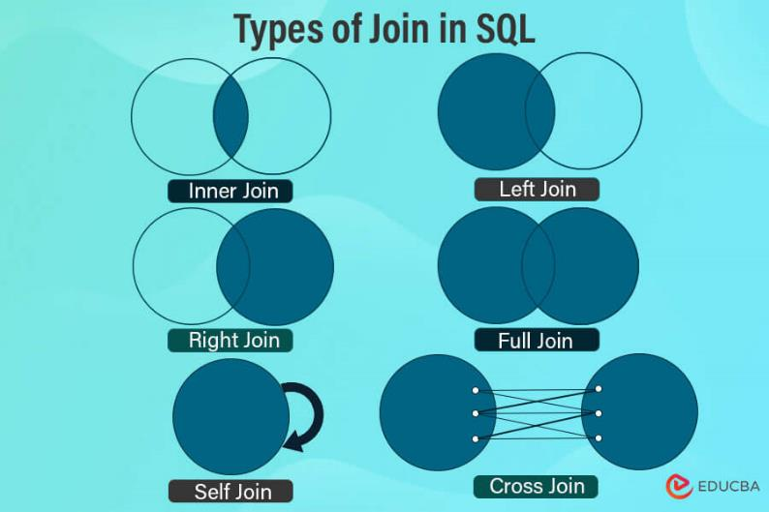
Learning 2 | My takeaways
Key learning: DBMS Joins
Key takeaways: Gained understanding of different types of joins such as inner, outer, left, and right joins, and how they retrieve related data from multiple tables.
How do I personally see this concept implemented in the Energy sector: In energy data management, using joins to efficiently analyze and integrate large datasets from various sources (like production and consumption records) is crucial.

Slide 6
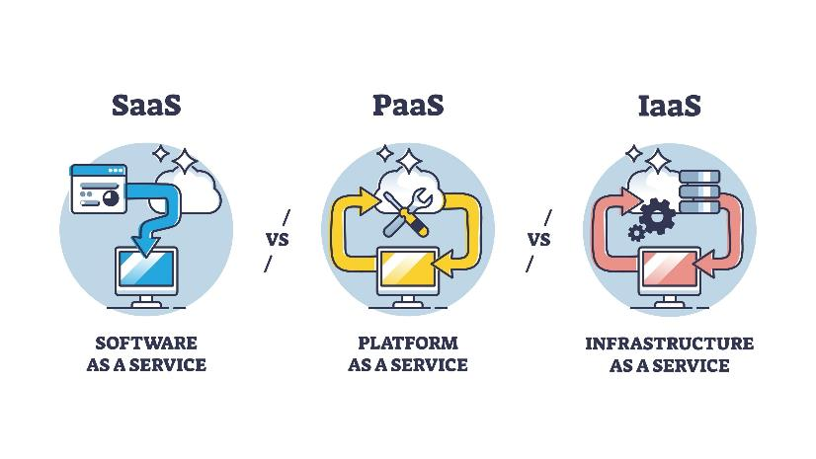
Learning 3 | My takeaways
Key learning: Cloud (IaaS, PaaS, SaaS)
Key takeaways: Explored the different service models in cloud computing. IaaS provides virtualized computing resources, PaaS enables developers to build applications, and SaaS delivers software over the internet.
How do I personally see this concept implemented in the Energy sector: Cloud platforms are widely used in energy companies for scalable infrastructure, software development, and remote data processing.

Slide 7

Relevance of learnings for my organization

Slide 8
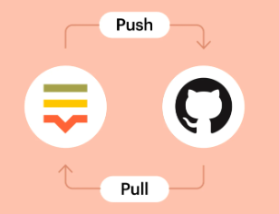
Learning 1 | Relevance for Shell
Shell implementation: Shell could implement GitHub Actions for automation in development and deployment processes.
Shell benefits: Continuous deployment and integration streamline updates are crucial for energy monitoring systems and data platforms.

Slide 9
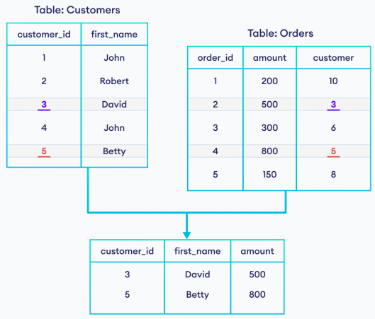
Learning 2 | Relevance for Shell
Shell implementation: Efficient use of joins to combine data from multiple sources in real-time energy monitoring applications.
Shell benefits: Optimizing energy usage through data analytics to reduce operational costs and improve energy efficiency.

Slide 10
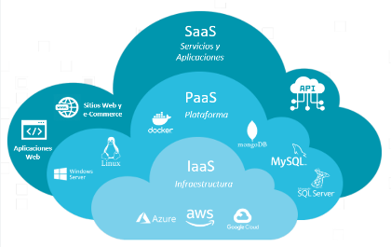
Learning 3 | Relevance for Shell
Shell implementation: Shell's adoption of cloud technologies (IaaS for virtualized infrastructure, PaaS for developing energy applications, SaaS for providing solutions to customers).
Shell benefits: Cloud services enhance scalability, reduce physical infrastructure costs, and allow flexible, remote operations in projects globally.

Slide 11

Challenges in implementing learning

Slide 12

Challenge faced while implementing Learning 1
Challenge: Struggling with setting up workflows for projects.
Solution: Studying use cases and experimenting with different templates to create efficient workflows.

Slide 13
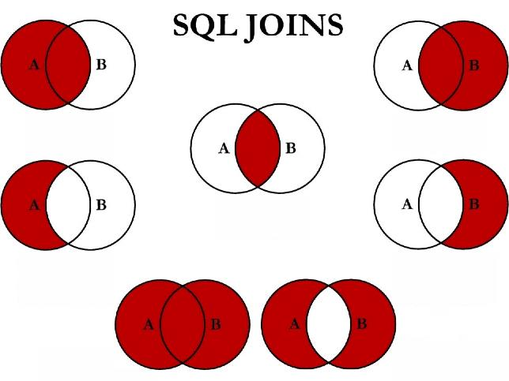
Challenge faced while implementing Learning 2
Challenge: Difficulty in optimizing complex queries involving multiple joins.
Solution: Practicing query optimization techniques and using tools to analyze query performance.

Slide 14
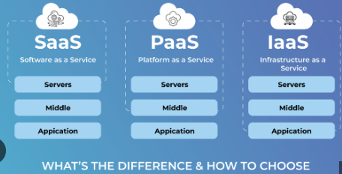
Challenge faced while implementing Learning 3
Challenge: Understanding which cloud model best fits different use cases (IaaS, PaaS, SaaS).
Solution: Taking more hands-on experience with cloud platforms (like Azure, AWS) and exploring real-world case studies.

Slide 15

Action Plan

Slide 16
My Action Plan for this Week
Actions
Timeline
Status
Setting up more GitHub workflows involving multiple actions
Practice DBMS joins
Experiment with cloud platforms (AWS/GCP)
End of the week
In progress

Slide 17

Learning is also Fun!

Slide 18
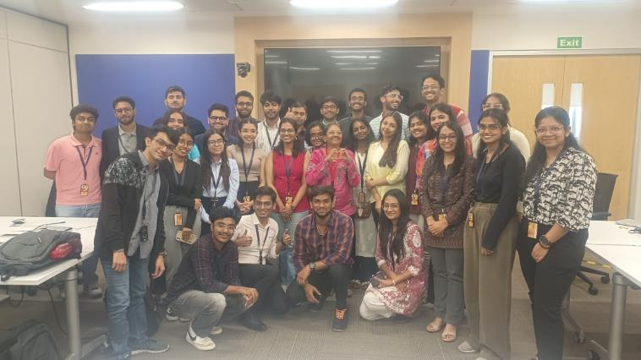
Learning is also Fun!
This week, we had a lot of fun working hands-on with databases. Creating tables, inserting and modifying data, and solving various queries not only helped us understand DBMS concepts better, but also turned into an engaging group activity.

Slide 19

Summary
This week, I explored three main concepts:
- DevOps: In specific, GitHub actions for automating workflows in CI/CD pipelines.
- DBMS: Creating tables, inserting, modifying data. Combining and analyzing data using joins.
- Cloud: Cloud models such as IaaS, PaaS, SaaS provide flexible solutions for infrastructure, platform and software services.
The concepts learned from this week form a foundation for future learning.

Slide 20
Thank You

